Slide 1
FUDGE: Controlled Text Generation With Future Discriminators
Kevin Yang and Dan Klein

Slide 2
Overview

Slide 3
Overview
What is controlled text generation?
Our method FUDGE: FUture Discriminators for GEneration
Experimental results + examples on 3 tasks

Slide 4
Overview
What is controlled text generation?
Our method FUDGE: FUture Discriminators for GEneration
Experimental results + examples on 3 tasks

Slide 5
Overview
What is controlled text generation?
Our method FUDGE: FUture Discriminators for GEneration
Experimental results + examples on 3 tasks

Slide 6
What’s Controlled Text Generation?

Slide 7

What’s Controlled Text Generation?
Language Model

Slide 8
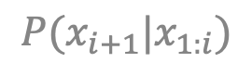
What’s Controlled Text Generation?
Language Model
$$P(x_{i+1}|x_{1:i})$$

Slide 9
What’s Controlled Text Generation?
Generate Text:
Language Model
$$P(x_{i+1}|x_{1:i})$$

Slide 10
What’s Controlled Text Generation?
Generate Text:
The issue focused on
Language Model
$$P(x_{i+1}|x_{1:i})$$

Slide 11
What’s Controlled Text Generation?
Generate Text:
The issue focused on
the role of a small company called Korn Ferry, which operates two vessels, the Korn and…
Language Model
$$P(x_{i+1}|x_{1:i})$$

Slide 12

What’s Controlled Text Generation?
Generate Text:
The issue focused on
the role of a small company called Korn Ferry, which operates two vessels, the Korn and…
Language Model
$$P(x_{i+1}|x_{1:i})$$

Slide 13
What’s Controlled Text Generation?
Generate Text (Politics Topic):
The issue focused on
the role of a small company called Korn Ferry, which operates two vessels, the Korn and…
Language Model
$$P(x_{i+1}|x_{1:i})$$

Slide 14


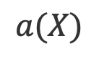
What’s Controlled Text Generation?
Generate Text (Politics Topic):
Politics
The issue focused on
the role of a small company called Korn Ferry, which operates two vessels, the Korn and…
Language Model
$$P(x_{i+1}|x_{1:i})$$
$$a(X)$$

Slide 15
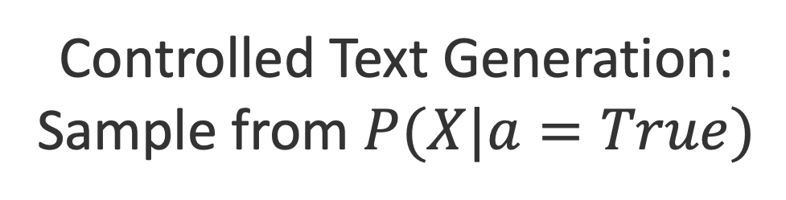
What’s Controlled Text Generation?
Generate Text (Politics Topic):
Politics
The issue focused on
the role of a small company called Korn Ferry, which operates two vessels, the Korn and…
Language Model
$$P(x_{i+1}|x_{1:i})$$
$$a(X)$$
Controlled Text Generation:
Sample from $P(X|a=True)$

Slide 16


What’s Controlled Text Generation?
Generate Text (Politics Topic):
Politics
The issue focused on
the role of a small company called Korn Ferry, which operates two vessels, the Korn and…
…
Language Model
$$P(x_{i+1}|x_{1:i})$$
$$a(X)$$
Controlled Text Generation:
Sample from $P(X|a=True)$

Slide 17

What’s Controlled Text Generation?
Generate Text (Politics Topic):
Politics
FUDGE
$$a(X)$$
Controlled Text Generation:
Sample from $P(X|a=True)$

Slide 18
What’s Controlled Text Generation?
Generate Text (Politics Topic):
Politics
The issue focused on
FUDGE
$$a(X)$$
Controlled Text Generation:
Sample from $P(X|a=True)$

Slide 19
What’s Controlled Text Generation?
Generate Text (Politics Topic):
Politics
The issue focused on whether the two institutions were operating within the bounds set by the constitution…
FUDGE
$$a(X)$$
Controlled Text Generation:
Sample from $P(X|a=True)$

Slide 20
What’s Controlled Text Generation?
Generate Text (Politics Topic):
Politics
The issue focused on whether the two institutions were operating within the bounds set by the constitution…
…
FUDGE
$$a(X)$$
Controlled Text Generation:
Sample from $P(X|a=True)$

Slide 21
Controlled Generation + Conditioning
Notes:
Distinguish control from conditioning
Up until this point, you might wonder, well, couldn’t you just sample a few generations until you get one that’s on topic, or a few different translations until you get one that’s formal?

Slide 22
Controlled Generation + Conditioning
Translate to English (Formal Style):
Translation Model
Notes:
Distinguish control from conditioning
Up until this point, you might wonder, well, couldn’t you just sample a few generations until you get one that’s on topic, or a few different translations until you get one that’s formal?

Slide 23
Controlled Generation + Conditioning
Translate to English (Formal Style):
[la información que que tenemos todo es propaganda entonces es portante ver otros versiones de lo que está pasando en el mundo]
Translation Model
Notes:
Distinguish control from conditioning
Up until this point, you might wonder, well, couldn’t you just sample a few generations until you get one that’s on topic, or a few different translations until you get one that’s formal?

Slide 24
Controlled Generation + Conditioning
[la información que que tenemos todo es propaganda entonces es portante ver otros versiones de lo que está pasando en el mundo]
Translate to English (Formal Style):
Translation Model
Notes:
Distinguish control from conditioning
Up until this point, you might wonder, well, couldn’t you just sample a few generations until you get one that’s on topic, or a few different translations until you get one that’s formal?

Slide 25
Controlled Generation + Conditioning
[la información que que tenemos todo es propaganda entonces es portante ver otros versiones de lo que está pasando en el mundo]
Translate to English (Formal Style):
the information that, that we have is all propaganda, then is important to see other versions of what’s happening…
Translation Model
Notes:
Distinguish control from conditioning
Up until this point, you might wonder, well, couldn’t you just sample a few generations until you get one that’s on topic, or a few different translations until you get one that’s formal?

Slide 26
Controlled Generation + Conditioning
[la información que que tenemos todo es propaganda entonces es portante ver otros versiones de lo que está pasando en el mundo]
Translate to English (Formal Style):
the information that, that we have is all propaganda, then is important to see other versions of what’s happening…
Translation Model
Notes:
Distinguish control from conditioning
Up until this point, you might wonder, well, couldn’t you just sample a few generations until you get one that’s on topic, or a few different translations until you get one that’s formal?

Slide 27

Controlled Generation + Conditioning
[la información que que tenemos todo es propaganda entonces es portante ver otros versiones de lo que está pasando en el mundo]
Translate to English (Formal Style):
the information that, that we have is all propaganda, then is important to see other versions of what’s happening…
Translation Model
Notes:
Distinguish control from conditioning
Up until this point, you might wonder, well, couldn’t you just sample a few generations until you get one that’s on topic, or a few different translations until you get one that’s formal?

Slide 28
Controlled Generation + Conditioning
[la información que que tenemos todo es propaganda entonces es portante ver otros versiones de lo que está pasando en el mundo]
Translate to English (Formal Style):
the information that, that we have is all propaganda, then is important to see other versions of what’s happening…
…
Translation Model
Notes:
Distinguish control from conditioning
Up until this point, you might wonder, well, couldn’t you just sample a few generations until you get one that’s on topic, or a few different translations until you get one that’s formal?

Slide 29
Controlled Generation + Conditioning
[la información que que tenemos todo es propaganda entonces es portante ver otros versiones de lo que está pasando en el mundo]
Translate to English (Formal Style):
the information that, that we have is all propaganda, then is important to see other versions of what’s happening…
…
Translation Model
FUDGE
Notes:
Distinguish control from conditioning
Up until this point, you might wonder, well, couldn’t you just sample a few generations until you get one that’s on topic, or a few different translations until you get one that’s formal?

Slide 30
Controlled Generation + Conditioning
[la información que que tenemos todo es propaganda entonces es portante ver otros versiones de lo que está pasando en el mundo]
Translate to English (Formal Style):
the information that, that we have is all propaganda, then is important to see other versions of what’s happening…
…
Translation Model
The information that we have is all propaganda, so, it’s important to see other versions of what’s happening…
FUDGE
Notes:
Distinguish control from conditioning
Up until this point, you might wonder, well, couldn’t you just sample a few generations until you get one that’s on topic, or a few different translations until you get one that’s formal?

Slide 31
Controlled Generation + Conditioning
[la información que que tenemos todo es propaganda entonces es portante ver otros versiones de lo que está pasando en el mundo]
Translate to English (Formal Style):
the information that, that we have is all propaganda, then is important to see other versions of what’s happening…
…
Translation Model
The information that we have is all propaganda, so, it’s important to see other versions of what’s happening…
…
FUDGE
Notes:
Distinguish control from conditioning
Up until this point, you might wonder, well, couldn’t you just sample a few generations until you get one that’s on topic, or a few different translations until you get one that’s formal?

Slide 32
What About Rejection Sampling?
[la información que que tenemos todo es propaganda entonces es portante ver otros versiones de lo que está pasando en el mundo]
Translate to English (Formal Style):
Translation Model
Notes:
Distinguish control from conditioning
Up until this point, you might wonder, well, couldn’t you just sample a few generations until you get one that’s on topic, or a few different translations until you get one that’s formal?

Slide 33
What About Rejection Sampling?
[la información que que tenemos todo es propaganda entonces es portante ver otros versiones de lo que está pasando en el mundo]
Translate to English (Formal Style):
the information that, that we have is all propaganda, then is important to see other versions of what’s happening…
the information that, that we have is all propaganda, so is important to see other versions of what’s happening…
Translation Model
the information that we have is all propaganda, then is important to see other versions of what’s happening…
the information that, that we have is all propaganda, then it is important to see other versions of what’s happening…
The information that we have is all propaganda, so it is important to see other versions of what’s happening…
Notes:
Distinguish control from conditioning
Up until this point, you might wonder, well, couldn’t you just sample a few generations until you get one that’s on topic, or a few different translations until you get one that’s formal?

Slide 34
What About Rejection Sampling?
[la información que que tenemos todo es propaganda entonces es portante ver otros versiones de lo que está pasando en el mundo]
Translate to English (Formal Style):
…
the information that, that we have is all propaganda, then is important to see other versions of what’s happening…
…
the information that, that we have is all propaganda, so is important to see other versions of what’s happening…
…
Translation Model
the information that we have is all propaganda, then is important to see other versions of what’s happening…
…
the information that, that we have is all propaganda, then it is important to see other versions of what’s happening…
…
The information that we have is all propaganda, so it is important to see other versions of what’s happening…
Notes:
Distinguish control from conditioning
Up until this point, you might wonder, well, couldn’t you just sample a few generations until you get one that’s on topic, or a few different translations until you get one that’s formal?

Slide 35
More Complex Constraints

Slide 36
More Complex Constraints
Generate Text (Poem):

Slide 37
More Complex Constraints
Generate Text (Poem):
And even thence thou wilt be stol'n, I fear,
Language Model

Slide 38
More Complex Constraints
Generate Text (Poem):
And even thence thou wilt be stol'n, I fear,
and thou art a good friend of mine. The King’s Guard…
Language Model

Slide 39
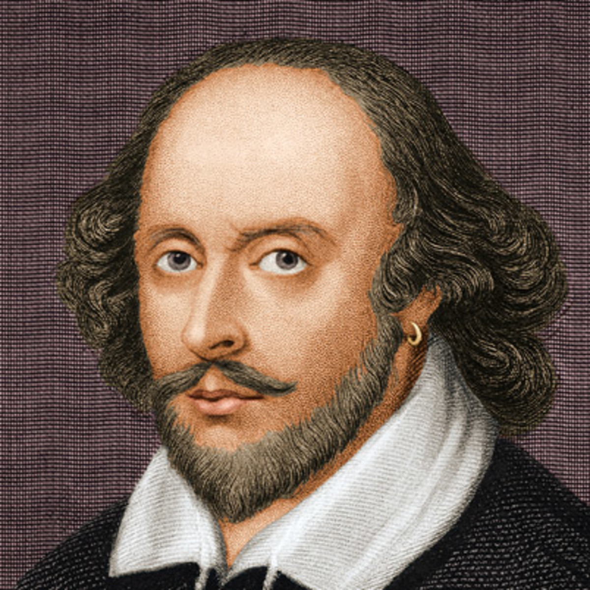

More Complex Constraints
Generate Text (Poem):
And even thence thou wilt be stol'n, I fear,
and thou art a good friend of mine. The King’s Guard…
Language Model

Slide 40
More Complex Constraints
Generate Text (Poem):
And even thence thou wilt be stol'n, I fear,
and thou art a good friend of mine. The King’s Guard…
…
Language Model

Slide 41
More Complex Constraints
Generate Text (Poem):
And even thence thou wilt be stol'n, I fear,
and thou art a good friend of mine. The King’s Guard…
…
Language Model
And even thence thou wilt be stol'n, I fear,
for this shall be the end. That’s pretty clear.
FUDGE

Slide 42

More Complex Constraints
Generate Text (Poem):
And even thence thou wilt be stol'n, I fear,
and thou art a good friend of mine. The King’s Guard…
…
Language Model
And even thence thou wilt be stol'n, I fear,
for this shall be the end. That’s pretty clear.
…
FUDGE

Slide 43
Some Controlled Generation Ideas
Notes:
Might need to retrain for different topics, and quality dependent on finetuning data, can overfit to finetuning data

Slide 44
Idea: Finetuning
Notes:
Might need to retrain for different topics, and quality dependent on finetuning data, can overfit to finetuning data

Slide 45
Idea: Finetuning
Generate Text (Politics Topic):
Notes:
Might need to retrain for different topics, and quality dependent on finetuning data, can overfit to finetuning data

Slide 46
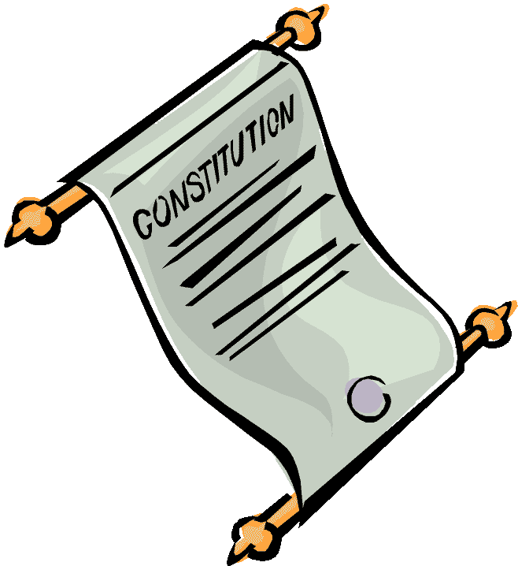
Idea: Finetuning
Generate Text (Politics Topic):
+
Politics Documents
Notes:
Might need to retrain for different topics, and quality dependent on finetuning data, can overfit to finetuning data

Slide 47
Idea: Guide With Classifier
Generate Text (Politics Topic):
Notes:
Admit: VERY oversimplified overview of prior work.

Slide 48
Idea: Guide With Classifier
Generate Text (Politics Topic):
Politics

Slide 49
Idea: Guide With Classifier
Generate Text (Politics Topic):
Politics
Politics
Notes:
Some use gradients, some just modify the output logits.

Slide 50
Idea: Guide With Classifier
Generate Text (Politics Topic):
Politics
Politics
Propagate gradients into model’s activations
Notes:
Some use gradients, some just modify the output logits.

Slide 51
Idea: Guide With Classifier
Generate Text (Politics Topic):
Politics
Politics
Propagate gradients into model’s activations
Modify model’s output logits
Notes:
Some use gradients, some just modify the output logits.

Slide 52
What the fudge is FUDGE?

Slide 53
What the fudge is FUDGE?
Use classifier + Bayesian factorization to judge continuations
Plan for the future, not for the present
Compose different attributes by training multiple predictors

Slide 54
What the fudge is FUDGE?
Use classifier + Bayesian factorization to judge continuations
Plan for the future, not for the present
Compose different attributes by training multiple predictors

Slide 55
What the fudge is FUDGE?
Use classifier + Bayesian factorization to judge continuations
Plan for the future, not for the present
Compose different attributes by training multiple classifiers

Slide 56
What the fudge is FUDGE?
Use classifier + Bayesian factorization to judge continuations
Plan for the future, not for the present
Compose different attributes by training multiple classifiers

Slide 57
Generation from Base $G$
Notes:
Should this be a poetry example? Wonder if it’s harder to explain…

Slide 58
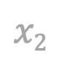
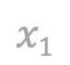
Generation from Base $G$
Do | you
$$x1$$
$$x2$$
Notes:
Should this be a poetry example? Wonder if it’s harder to explain…

Slide 59
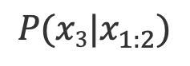
Generation from Base $G$
Do | you
$$x1$$
$$x2$$
$$P(x3|x_{1:2})$$
Notes:
Should this be a poetry example? Wonder if it’s harder to explain…

Slide 60
Generation from Base $G$
want | 0.4
prefer | 0.3
thus | 0.1
… | …
Do | you
$$x1$$
$$x2$$
$$P(x3|x_{1:2})$$
Notes:
Should this be a poetry example? Wonder if it’s harder to explain…

Slide 61
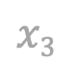
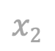
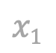
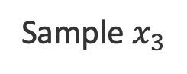
Generation from Base $G$
want | 0.4
prefer | 0.3
thus | 0.1
… | …
Sample $x_{3}$
Do | you
Do | you | want
$$x1$$
$$x2$$
$$x1$$
$$x2$$
$$x3$$
$$P(x3|x_{1:2})$$
Notes:
Should this be a poetry example? Wonder if it’s harder to explain…

Slide 62
Generation from Base $G$
Generate Text (Formal Style):
want | 0.4
prefer | 0.3
thus | 0.1
… | …
Sample $x_{3}$
Do | you
Do | you | want
$$x1$$
$$x2$$
$$x1$$
$$x2$$
$$x3$$
$$P(x3|x_{1:2})$$
Notes:
Should this be a poetry example? Wonder if it’s harder to explain…

Slide 63
Generation from Base $G$
Generate Text (Formal Style):
want | 0.4
prefer | 0.3
thus | 0.1
… | …
Sample $x_{3}$
Do | you
Do | you | want
$$x1$$
$$x2$$
$$x1$$
$$x2$$
$$x3$$
$$P(x3|x_{1:2})$$
…
Notes:
Should this be a poetry example? Wonder if it’s harder to explain…

Slide 64
How Does FUDGE Work?

Slide 65

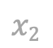
How Does FUDGE Work?
Generate Text (Formal Style):
want | 0.4
prefer | 0.3
thus | 0.1
… | …
Do | you
$$x1$$
$$x2$$

Slide 66
How Does FUDGE Work?
Generate Text (Formal Style):
want | 0.4
prefer | 0.3
thus | 0.1
… | …
Do | you
$$x1$$
$$x2$$
want | X
prefer | +
thus | +
… | …
Notes:
Note that you’re judging each continuation: do you want, do you prefer, etc.

Slide 67
How Does FUDGE Work?
Generate Text (Formal Style):
want | 0.4
prefer | 0.3
thus | 0.1
… | …
want | X
prefer | 0.3
thus | 0.1
… | …
Do | you
$$x1$$
$$x2$$
want | X
prefer | +
thus | +
… | …

Slide 68
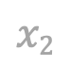
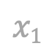
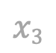
How Does FUDGE Work?
Generate Text (Formal Style):
want | 0.4
prefer | 0.3
thus | 0.1
… | …
want | X
prefer | 0.3
thus | 0.1
… | …
Do | you
Select from +
Do | you | prefer
$$x1$$
$$x2$$
want | X
prefer | +
thus | +
… | …
$$x1$$
$$x2$$
$$x3$$

Slide 69
How Does FUDGE Work?
Generate Text (Formal Style):
want | 0.4
prefer | 0.3
thus | 0.1
… | …
want | X
prefer | 0.3
thus | 0.1
… | …
Do | you
Select from +
Do | you | prefer
$$x1$$
$$x2$$
want | X
prefer | +
thus | +
… | …
$$x1$$
$$x2$$
$$x3$$

Slide 70
How Does FUDGE Work?
Generate Text (Formal Style):
want | 0.4
prefer | 0.3
thus | 0.1
… | …
want | X
prefer | 0.3
thus | 0.1
… | …
Do | you
Select from +
Do | you | prefer
$$x1$$
$$x2$$
want | X
prefer | +
thus | +
… | …
$$x1$$
$$x2$$
$$x3$$
…

Slide 71
How Does FUDGE Work?
Generate Text (Formal Style):
want | 0.4
prefer | 0.3
thus | 0.1
… | …
want | X
prefer | 0.3
thus | 0.1
… | …
Do | you
Select from +
Do | you | prefer
$$x1$$
$$x2$$
want | X
prefer | +
thus | +
… | …
$$x1$$
$$x2$$
$$x3$$
…

Slide 72

How Does FUDGE Work?
Generate Text (Formal Style):
want | 0.4
prefer | 0.3
thus | 0.1
… | …
want | X
prefer | 0.3
thus | 0.1
… | …
Do | you
Select from +
Do | you | prefer
$$x1$$
$$x2$$
want | X
prefer | +
thus | +
… | …
$$x1$$
$$x2$$
$$x3$$
…
Notes:
Explain prefix acceptor. Difference might be subtle in formality, but the difference will be much clearer in later examples.

Slide 73
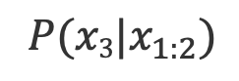
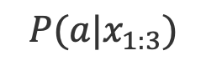
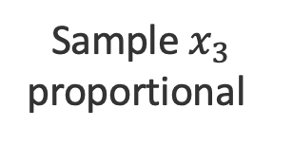
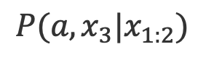
How Does FUDGE Work?
Generate Text (Formal Style):
want | 0.4
prefer | 0.3
thus | 0.1
… | …
$P(x3|x_{1:2})$
$$P(a,x_{3}|x_{1:2})$$
want | 0.08
prefer | 0.24
thus | 0.09
… | …
Sample $x_{3}$
proportional
Do | you
Do | you | prefer
$$x1$$
$$x2$$
want | 0.2
prefer | 0.8
thus | 0.9
… | …
$$x1$$
$$x2$$
$$x3$$
$$P(a|x_{1:3})$$
…

Slide 74
How Does FUDGE Work?
Generate Text (Formal Style):
want | 0.4
prefer | 0.3
thus | 0.1
… | …
$P(x3|x_{1:2})$
$$P(a,x_{3}|x_{1:2})$$
want | 0.08
prefer | 0.24
thus | 0.09
… | …
Sample $x_{3}$
proportional
Do | you
Do | you | prefer
$$x1$$
$$x2$$
want | 0.2
prefer | 0.8
thus | 0.9
… | …
$$x1$$
$$x2$$
$$x3$$
$$P(a|x_{1:3})$$
…

Slide 75
How Does FUDGE Work?
Generate Text (Formal Style):
want | 0.4
prefer | 0.3
thus | 0.1
… | …
$P(x3|x_{1:2})$
$$P(a,x_{3}|x_{1:2})$$
want | 0.08
prefer | 0.24
thus | 0.09
… | …
Sample $x_{3}$
proportional
Do | you
Do | you | prefer
$$x1$$
$$x2$$
want | 0.2
prefer | 0.8
thus | 0.9
… | …
$$x1$$
$$x2$$
$$x3$$
$$P(a|x_{1:3})$$
…

Slide 76
How Does FUDGE Do?
Notes:
Distinguish control from conditioning
Up until this point, you might wonder, well, couldn’t you just sample a few generations until you get one that’s on topic, or a few different translations until you get one that’s formal?

Slide 77
How Does FUDGE Do?
[la información que que tenemos todo es propaganda entonces es portante ver otros versiones de lo que está pasando en el mundo]
Translate to English (Formal Style):
the information that, that we have is all propaganda, then is important to see other versions of what’s happening…
…
Translation Model
The information that we have is all propaganda, so, it’s important to see other versions of what’s happening…
…
FUDGE
Notes:
Distinguish control from conditioning
Up until this point, you might wonder, well, couldn’t you just sample a few generations until you get one that’s on topic, or a few different translations until you get one that’s formal?

Slide 78
How Does FUDGE Do?
[la información que que tenemos todo es propaganda entonces es portante ver otros versiones de lo que está pasando en el mundo]
Translate to English (Formal Style):
the information that, that we have is all propaganda, then is important to see other versions of what’s happening…
…
Translation Model
The information that
FUDGE
Notes:
Distinguish control from conditioning
Up until this point, you might wonder, well, couldn’t you just sample a few generations until you get one that’s on topic, or a few different translations until you get one that’s formal?

Slide 79
How Does FUDGE Do?
[la información que que tenemos todo es propaganda entonces es portante ver otros versiones de lo que está pasando en el mundo]
Translate to English (Formal Style):
the information that, that we have is all propaganda, then is important to see other versions of what’s happening…
…
Translation Model
The information that
FUDGE
Notes:
Distinguish control from conditioning
Up until this point, you might wonder, well, couldn’t you just sample a few generations until you get one that’s on topic, or a few different translations until you get one that’s formal?

Slide 80
How Does FUDGE Do?
[la información que que tenemos todo es propaganda entonces es portante ver otros versiones de lo que está pasando en el mundo]
Translate to English (Formal Style):
the information that, that we have is all propaganda, then is important to see other versions of what’s happening…
…
Translation Model
The information that we have
FUDGE
Notes:
Distinguish control from conditioning
Up until this point, you might wonder, well, couldn’t you just sample a few generations until you get one that’s on topic, or a few different translations until you get one that’s formal?

Slide 81
How Does FUDGE Do?
[la información que que tenemos todo es propaganda entonces es portante ver otros versiones de lo que está pasando en el mundo]
Translate to English (Formal Style):
the information that, that we have is all propaganda, then is important to see other versions of what’s happening…
…
Translation Model
The information that we have is all propaganda, so, it’s important to see other versions of what’s happening…
…
FUDGE
Notes:
Distinguish control from conditioning
Up until this point, you might wonder, well, couldn’t you just sample a few generations until you get one that’s on topic, or a few different translations until you get one that’s formal?

Slide 82
How Does FUDGE Do?
Translate to English (Formal Style):
Predicted probability of formality, avg. over test
FUDGE
0.47
Best prior method
0.41
Notes:
Make sure you’re not saying that you could run simple WD here instead

Slide 83
How Does FUDGE Do?
Translate to English (Formal Style):
Predicted probability of formality, avg. over test
FUDGE
0.47
Best prior method
0.41
Test BLEU
FUDGE
22.18
Best prior method
22.03
Notes:
Make sure you’re not saying that you could run simple WD here instead

Slide 84
What the fudge is FUDGE?
Use classifier + Bayesian factorization to judge continuations
Plan for the future, not for the present
Compose different attributes by training multiple classifiers

Slide 85
What the fudge is FUDGE?
Use classifier + Bayesian factorization to judge continuations
Plan for the future, not for the present
Compose different attributes by training multiple classifiers
vs

Slide 86
Planning for the Future: Topic Control
Generate Text (Politics Topic)
Notes:
Discuss WD baseline doesn’t work. What would the baseline do? Show words one by one. Discuss the “no” choice.

Slide 87
Planning for the Future: Topic Control
Generate Text (Use “Constitution”):
*(simplified version of
politics topic)
Notes:
Discuss WD baseline doesn’t work. What would the baseline do? Show words one by one. Discuss the “no” choice. WD has been used as a baseline

Slide 88
Planning for the Future: Topic Control
Generate Text (Use “Constitution”):
Constitution
Grep for “constitution”
Notes:
Discuss WD baseline doesn’t work. What would the baseline do? Show words one by one. Discuss the “no” choice. WD has been used as a baseline

Slide 89
Planning for the Future: Topic Control
Generate Text (Use “Constitution”):
Constitution
Constitution
Grep for “constitution”
Does this continuation make
“constitution” more likely later?
Notes:
Discuss WD baseline doesn’t work. What would the baseline do? Show words one by one. Discuss the “no” choice. WD has been used as a baseline

Slide 90
How to Learn aaaa
Constitution

Slide 91
How to Learn aaaa
Constitution
Raw Training Data
The founding fathers
wrote the constitution
of the USA.

Slide 92
How to Learn aaaa
Constitution
Constitution
Raw Training Data
Training Data for
The founding fathers
wrote the constitution
of the USA.
(The, True) (The founding, True)
(The founding fathers, True) …

Slide 93
How to Learn aaaa
Constitution
Constitution
Raw Training Data
Training Data for
The founding fathers
wrote the constitution
of the USA.
(The, True) (The founding, True)
(The founding fathers, True) …
Natural language
processing is great!

Slide 94
How to Learn aaaa
Constitution
Constitution
Raw Training Data
Training Data for
The founding fathers
wrote the constitution
of the USA.
(The, True) (The founding, True)
(The founding fathers, True) …
Natural language
processing is great!
(Natural, False) (Natural language, False)
(Natural language processing, False) …

Slide 95
Planning for the Future: Topic Control
Generate Text (Use “Constitution”):
Notes:
Discuss WD baseline doesn’t work. What would the baseline do? Show words one by one. Discuss the “no” choice.

Slide 96
Planning for the Future: Topic Control
Generate Text (Use “Constitution”):
The issue focused on
FUDGE
Notes:
Discuss WD baseline doesn’t work. What would the baseline do? Show words one by one. Discuss the “no” choice.

Slide 97
Planning for the Future: Topic Control
Generate Text (Use “Constitution”):
The issue focused on whether the two
FUDGE
Notes:
Discuss WD baseline doesn’t work. What would the baseline do? Show words one by one. Discuss the “no” choice.

Slide 98
Planning for the Future: Topic Control
Generate Text (Use “Constitution”):
Constitution
The issue focused on whether the two
FUDGE
Notes:
Discuss WD baseline doesn’t work. What would the baseline do? Show words one by one. Discuss the “no” choice.

Slide 99
Planning for the Future: Topic Control
Generate Text (Use “Constitution”):
Constitution
The issue focused on whether the two
constitution
FUDGE
Notes:
Discuss WD baseline doesn’t work. What would the baseline do? Show words one by one. Discuss the “no” choice.

Slide 100
Planning for the Future: Topic Control
Generate Text (Use “Constitution”):
The issue focused on whether the two
FUDGE
Notes:
Discuss WD baseline doesn’t work. What would the baseline do? Show words one by one. Discuss the “no” choice.

Slide 101
Planning for the Future: Topic Control
Generate Text (Use “Constitution”):
Constitution
The issue focused on whether the two
FUDGE
Notes:
Discuss WD baseline doesn’t work. What would the baseline do? Show words one by one. Discuss the “no” choice.

Slide 102
Planning for the Future: Topic Control
Generate Text (Use “Constitution”):
Constitution
The issue focused on whether the two
FUDGE
Key Idea:
Write something now, which increases
likelihood of constitution in the future
Notes:
Discuss WD baseline doesn’t work. What would the baseline do? Show words one by one. Discuss the “no” choice.

Slide 103
Planning for the Future: Topic Control
Generate Text (Use “Constitution”):
Constitution
The issue focused on whether the two institutions
FUDGE
Key Idea:
Write institutions now, which increases
likelihood of constitution in the future
Notes:
Discuss WD baseline doesn’t work. What would the baseline do? Show words one by one. Discuss the “no” choice.

Slide 104
Planning for the Future: Topic Control
Generate Text (Use “Constitution”):
Constitution
Constitution
The issue focused on whether the two institutions were operating within the bounds set by the constitution…
FUDGE
Key Idea:
Write institutions now, which increases
likelihood of constitution in the future
Notes:
Discuss WD baseline doesn’t work. What would the baseline do? Show words one by one. Discuss the “no” choice.

Slide 105
Planning for the Future: Topic Control
Generate Text (Use “Constitution”):
Constitution
Constitution
The issue focused on whether the two institutions were operating within the bounds set by the constitution…
…
FUDGE
Key Idea:
Write institutions now, which increases
likelihood of constitution in the future
Notes:
Discuss WD baseline doesn’t work. What would the baseline do? Show words one by one. Discuss the “no” choice.

Slide 106
Results: Topic Control
Generate Text (Varied Topics):
% on topic, human evaluations
FUDGE
74%
Best prior method
45%

Slide 107
Results: Topic Control
Generate Text (Varied Topics):
% on topic, human evaluations
FUDGE
74%
Best prior method
45%
Avg. fluency (1-5), human evaluations
FUDGE
4.16
Best prior method
4.05

Slide 108
What the fudge is FUDGE?
Use classifier + Bayesian factorization to judge continuations
Plan for the future, not for the present
Compose different attributes by training multiple classifiers

Slide 109
Compositionality

Slide 110
Compositionality
Generate Text (Formal Style):
want | 0.4
prefer | 0.3
thus | 0.1
… | …
$$P(a,x_{3}|x_{1:2})$$
want | 0.08
prefer | 0.24
thus | 0.09
… | …
Sample $x_{3}$
proportional
Do | you
Do | you | prefer
$$x1$$
$$x2$$
want | 0.2
prefer | 0.8
thus | 0.9
… | …
$$x1$$
$$x2$$
$$x3$$

Slide 111
Compositionality
Generate Text (Formal Style):
want | 0.4
prefer | 0.3
thus | 0.1
… | …
$$P(a,x_{3}|x_{1:2})$$
want | 0.08
prefer | 0.24
thus | 0.09
… | …
Sample $x_{3}$
proportional
Do | you
Do | you | prefer
$$x1$$
$$x2$$
want | 0.2
prefer | 0.8
thus | 0.9
… | …
$$x1$$
$$x2$$
$$x3$$
…

Slide 112

Compositionality
Generate Text (Formal Style, Math Topic):
want | 0.4
prefer | 0.3
thus | 0.1
… | …
$$P(a,x_{3}|x_{1:2})$$
want | 0.08
prefer | 0.24
thus | 0.09
… | …
Sample $x_{3}$
proportional
Do | you
Do | you | prefer
$$x1$$
$$x2$$
want | 0.2
prefer | 0.8
thus | 0.9
… | …
$$x1$$
$$x2$$
$$x3$$
$$π$$

Slide 113
Compositionality
Generate Text (Formal Style, Math Topic):
want | 0.4
prefer | 0.3
thus | 0.1
… | …
$$P(a,x_{3}|x_{1:2})$$
want | 0.08
prefer | 0.24
thus | 0.09
… | …
Sample $x_{3}$
proportional
Do | you
Do | you | prefer
$$x1$$
$$x2$$
want | 0.2
prefer | 0.8
thus | 0.9
… | …
$$x1$$
$$x2$$
$$x3$$
$$π$$
…

Slide 114
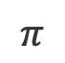
Compositionality
Generate Text (Formal Style, Math Topic):
want | 0.4
prefer | 0.3
thus | 0.1
… | …
$$P(a,x_{3}|x_{1:2})$$
want | 0.08
prefer | 0.24
thus | 0.09
… | …
Sample $x_{3}$
proportional
Do | you
Do | you | prefer
$$x1$$
$$x2$$
want | 0.2
prefer | 0.8
thus | 0.9
… | …
$$x1$$
$$x2$$
$$x3$$
$$π$$
want | 0.3
prefer | 0.1
thus | 0.9
… | …
$$π$$

Slide 115
Compositionality
Generate Text (Formal Style, Math Topic):
want | 0.4
prefer | 0.3
thus | 0.1
… | …
$$P(a,x_{3}|x_{1:2})$$
want | 0.08
prefer | 0.24
thus | 0.09
… | …
Sample $x_{3}$
proportional
Do | you
Do | you | prefer
$$x1$$
$$x2$$
want | 0.2
prefer | 0.8
thus | 0.9
… | …
$$x1$$
$$x2$$
$$x3$$
$$π$$
want | 0.3
prefer | 0.1
thus | 0.9
… | …
…
$$π$$

Slide 116
Compositional Constraints in Practice

Slide 117
Compositional Constraints in Practice
Generate Text (Poem):
And even thence thou wilt be stol'n, I fear,
and thou art a good friend of mine. The King’s Guard…
…
Language Model
And even thence thou wilt be stol'n, I fear,
for this shall be the end. That’s pretty clear.
…
FUDGE

Slide 118
Compositional Constraints in Practice
Generate Text (Poem):
Iambic meter
And even thence thou wilt be stol'n, I fear,
for this shall be the end. That’s pretty clear.
…
FUDGE

Slide 119
Compositional Constraints in Practice
Generate Text (Poem):
Iambic meter
Rhyme after 10 syllables
And even thence thou wilt be stol'n, I fear,
for this shall be the end. That’s pretty clear.
…
FUDGE

Slide 120
Compositional Constraints in Practice
Generate Text (Poem):
Iambic meter
Rhyme after 10 syllables
End the sentence after 10 syllables
And even thence thou wilt be stol'n, I fear,
for this shall be the end. That’s pretty clear.
…
FUDGE

Slide 121
Compositional Constraints in Practice
Generate Text (Poem):
Iambic meter
Rhyme after 10 syllables
End the sentence after 10 syllables
And even thence thou wilt be stol'n, I fear,
for this shall be the end. That’s pretty clear.
FUDGE

Slide 122
Compositional Constraints in Practice
Generate Text (Poem):
Iambic meter
Rhyme after 10 syllables
End the sentence after 10 syllables
And even thence thou wilt be stol'n, I fear,
for this shall be the end. That’s pretty clear.
FUDGE

Slide 123
Compositional Constraints in Practice
Generate Text (Poem):
Iambic meter
Rhyme after 10 syllables
End the sentence after 10 syllables
And even thence thou wilt be stol'n, I fear,
for this shall be the end. That’s clear
FUDGE

Slide 124
Compositional Constraints in Practice
Generate Text (Poem):
Iambic meter
Rhyme after 10 syllables
End the sentence after 10 syllables
And even thence thou wilt be stol'n, I fear,
for this shall be the end. That’s clear
…
FUDGE

Slide 125
Compositional Constraints in Practice
Generate Text (Poem):
Iambic meter
Rhyme after 10 syllables
End the sentence after 10 syllables
And even thence thou wilt be stol'n, I fear,
for this shall be the end. That’s pretty
FUDGE

Slide 126
Compositional Constraints in Practice
Generate Text (Poem):
Iambic meter
Rhyme after 10 syllables
End the sentence after 10 syllables
And even thence thou wilt be stol'n, I fear,
for this shall be the end. That’s pretty clear.
FUDGE

Slide 127
Compositional Constraints in Practice
Generate Text (Poem):
Iambic meter
Rhyme after 10 syllables
End the sentence after 10 syllables
And even thence thou wilt be stol'n, I fear,
for this shall be the end. That’s pretty clear.
…
FUDGE

Slide 128
Results: Poetry Couplet Completion
Generate Text (Poem):
Iambic
Rhyme after 10 syllables
End the sentence after 10 syllables
% successful (iambic + rhyme + end sentence)
FUDGE
44%
Best prior method
21%

Slide 129
Takeaways
Use predictor + Bayesian factorization to judge continuations
Plan for the future, not for the present
Compose different attributes by training multiple predictors
Code: https://github.com/yangkevin2/naacl-2021-fudge-controlled-generation

Slide 130
Takeaways
FUDGE: simple, flexible method for controlled generation
Use predictor + Bayesian factorization to judge continuations
Plan for the future, not for the present
Compose different attributes by training multiple predictors
Code: https://github.com/yangkevin2/naacl-2021-fudge-controlled-generation

Slide 131
Takeaways
FUDGE: simple, flexible method for controlled generation
Use classifier + Bayesian factorization to judge continuations
Plan for the future, not for the present
Compose different attributes by training multiple classifiers
Code: https://github.com/yangkevin2/naacl-2021-fudge-controlled-generation

Slide 132
Takeaways
FUDGE: simple, flexible method for controlled generation
Use classifier + Bayesian factorization to judge continuations
Plan for the future, not for the present
Compose different attributes by training multiple classifiers
Code: https://github.com/yangkevin2/naacl-2021-fudge-controlled-generation

Slide 133
Thank you!
Image Sources
https://discord.com/
https://pngtree.com/freepng/cartoon-crystal-ball-element_4188442.html
https://www.vexels.com/png-svg/preview/145736/ideas-machine-cartoon
https://www.istockphoto.com/vector/chocolate-brownie-square-gm1148649418-310267704
https://www.whitehousehistory.org/galleries/presidential-portraits
https://www.biography.com/writer/william-shakespeare
https://www.clipartkey.com/downpng/hTxJwh_constitution-clipart/

Slide 134
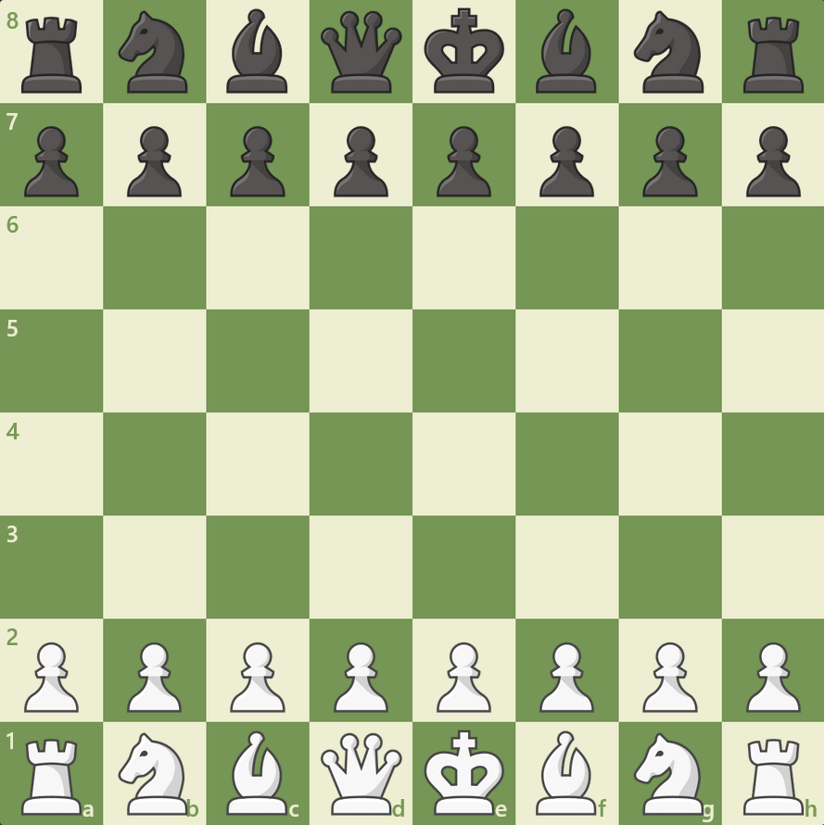
Other Applications: Game-Playing Agents
Example: Chess
Base model: Lc0 “probabilities”
Attribute: Hardcoded flags, e.g.,
will I castle in the next 5 moves?
will I capture a piece in the next 5 moves?
Limitation: train predictor for each flag
This actually works (I tried it as a preliminary experiment)

Slide 135
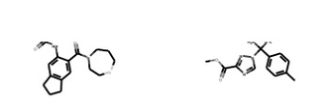
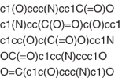
Other Applications: Molecular Design
Want: molecule with desired properties
Base model: Molecule generator
Can be string-based or graph-based
Attribute: Will the final molecule have the desired property?
Predictor operates on partially generated molecules

